Slide 1
Hackathon Idea Submission

Slide 2
👨‍👦‍👦 Team name and member details
Team Name: Samptr0n
Member 1: Devesh Chaudhary
Member 2: Aditi
📝 Theme Name: Sustainable Energy Solutions

Slide 3
Problem
We've identified key areas signaling urgent concerns alongside significant opportunities for enhancement. These domains present critical challenges that demand immediate and innovative solutions for improvement.
Suboptimal Asset Management
Inadequate Energy Usage Optimization
Poor maintenance strategies inflate asset lifespan estimates by 20-30%, causing billions in annual losses.
Reactive maintenance model in energy asset management incurs substantial costs, with unexpected downtimes of wind turbines alone causing up to $30,000 in daily losses per turbine.
Outdated 2D and basic 3D modeling fail to optimize asset management,
Renewable energy integration is hindered by up to a 40% supply-demand mismatch during variable weather, maintaining reliance on fossil fuels.
Millions of tons of additional CO2 emissions annually, despite renewables comprising 29% of global electricity production in 2020.
Fossil fuels still dominate 61% of electricity generation, highlighting a significant missed opportunity for carbon reduction.
Inefficient Energy Integration
Carbon Credit Trading Inefficiencies
Commercial buildings waste up to 30% of energy due to inadequate real-time management tools.
Causing hundreds of millions of tons of excess CO2 emissions annually.
Lack of advanced demand-response and predictive analytics keeps energy systems from operating at peak efficiency, unnecessarily enlarging the carbon footprint.
Over 20 disparate carbon trading systems and no standardized verification processes lead to a fragmented, inefficient market.
Market inefficiencies discourage investment in carbon reduction projects, slowing global emission reduction efforts.
Carbon credit price variability, ranging from $1 to over $50 per ton of CO2, complicates strategic planning for emission reduction initiatives.

Slide 4
Our Solution
We propose a cutting-edge framework leveraging the synergistic capabilities of Neural Radiance Fields (NeRF), Gen AI and Blockchain.
Designed to seamlessly integrate with existing enterprise systems, our solution addresses the intricate demands of contemporary energy systems and champions environmental sustainability through its following 3 core components:
High-Fidelity 3D Modeling with NeRF
Utilize NeRF to create photorealistic 3D models from images and live feeds, enhancing asset analysis and optimization. This allows for the simulation of environmental impacts on energy efficiency, guiding the strategic deployment of solar panels and other renewable resources.
Gen AI-Enhanced Environmental Analysis: Incorporate Gen AI with 3D models for deep environmental analysis, uncovering insights like geography's influence on renewable outputs. Enables precise scenario testing for optimal asset location and design, improving renewable energy system performance.
Real-Time Predictive Maintenance and Hidden Factor Analysis along with integration of LLM
Combine AI and stochastic models to identify equipment failures and hidden operational inefficiencies in real-time, significantly reducing unplanned downtime.
Enhanced Decision-Making with Conversational AI and LLM Insights: Implement LLMs for advanced conversational interfaces, enabling immediate access to operational insights and expert-level knowledge extraction.
Optimized Alerting and Failure Remediation: Integrate AI-enabled, risk-based alerting with stochastic modeling to dynamically prioritize critical alerts, improving worker response efficiency.
Carbon Credit Trading Marketplace
Using blockchain to establish a decentralized network for carbon credit management, optimizing the use of surplus credits. It transforms carbon credit trading, ensuring market transparency and security. This facilitates efficient trading, spurs investments and supports global efforts in emission reduction.

Slide 5
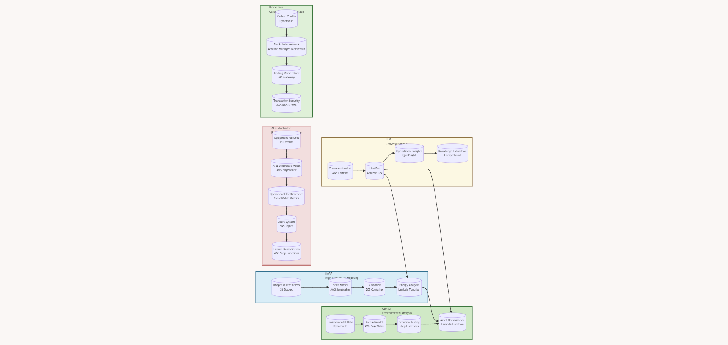
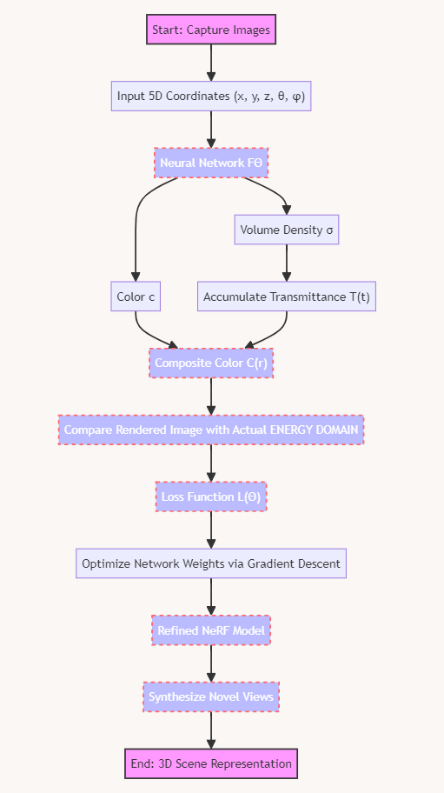
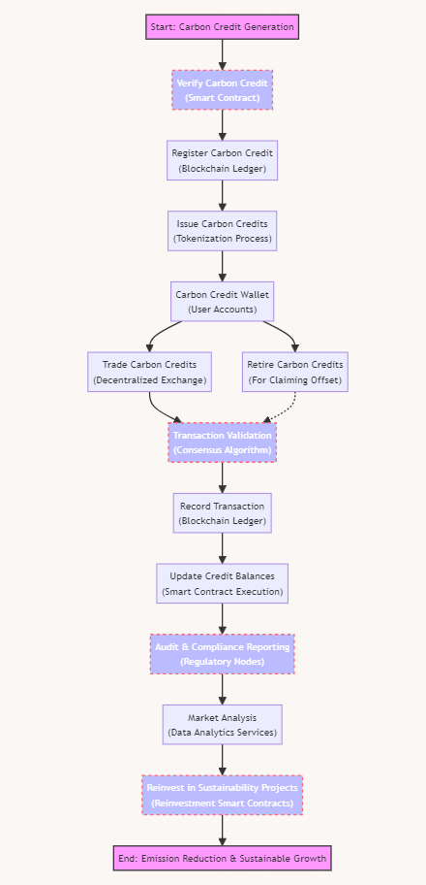
Wireframes
(Zooming-in will give you a clear quality of components.)
Complete Framework consisting all 3 components
Our NeRF algorithm catered for this use-case
Carbon Credit Marketplace

Slide 6
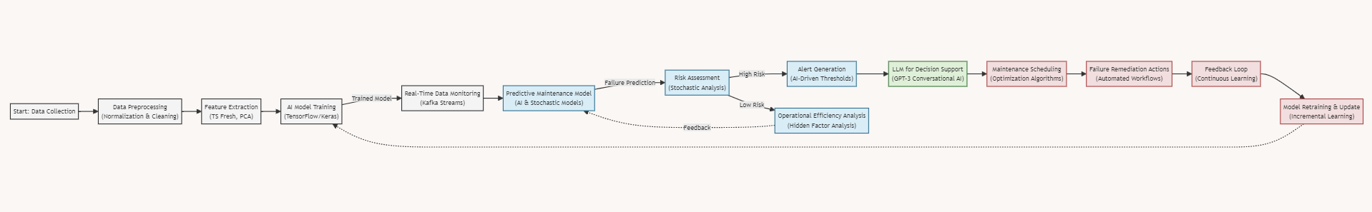

Real-Time Predictive Maintenance and Hidden Factor Analysis along with integration of LLM
NeRf generated image (sample), almost resembles real life world.

Slide 7




Business Relevance and Impact
Energy Sector
01
Carbon Credit Market
The global renewable energy market is projected to hit $1.5 trillion by 2025; leveraging NeRF and AI for asset optimization could drastically improve efficiency.
02
Continuous Improvement
The voluntary carbon market's rapid growth, surpassing $1 billion in 2021 transactions, could further accelerate with blockchain-enhanced transparency.
Innovation in 3D Modeling
03
AI's continuous learning ability ensures the system adapts to new insights and technological advances, keeping it at innovation's cutting edge
NeRF's unique use in energy asset modeling and environmental analysis provides unparalleled accuracy, significantly improving strategic decision-making and planning.
04

Slide 8
Thank You

